Slide 1
Encryption Tool Project
AUGUST 2025. BJÖRN HALLSTRÖM AND JOHN PROSSER
NOD CODING BOOTCAMP PROJECT 1

Slide 2
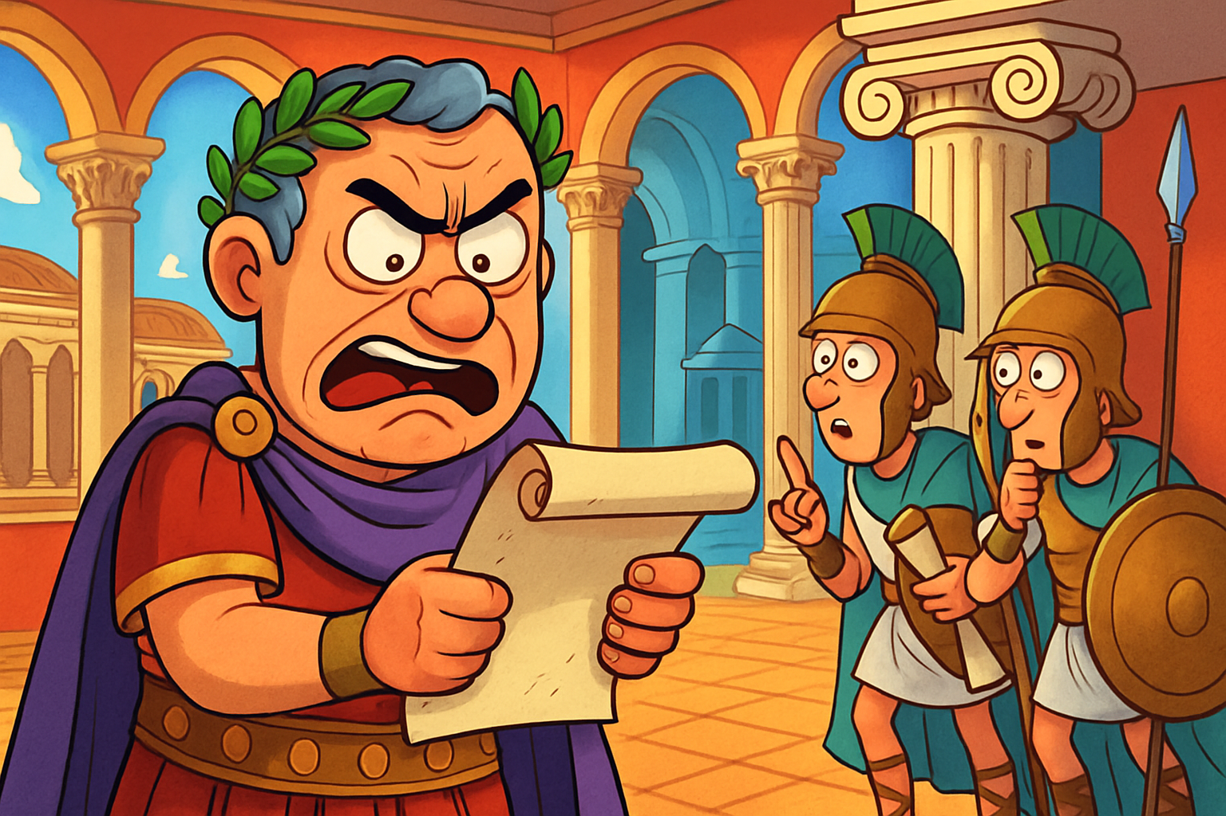
Caesar! We have problem!
NOD CoDING BOOTCAMP PROJECT 1: MESSAGE ENCRYPTION TOOL
Those pesky Greeks are intercepting your messages to the generals!

Slide 3
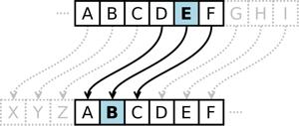
Solution: The Caesar Cipher!
NOD CoDING BOOTCAMP PROJECT 1: MESSAGE ENCRYPTION TOOL
Example: Key = -3
Shift all letter’s down by 3.
Let’s shift all letters in the alphabet to a different letter using a key, so the message is unreadable!
The generals in the field can recover the message by using the same key.
“hello world” becomes “ebiil tloia”
Notes:
The Caesar cipher is a very simple form of encrypting a message.
To encrypt the message we use an integer that we call a key.
We will use this key to shift all the letters in a message to a different letter.
For example, if the key was - 3 we would move backwards in the alphabet by 3 steps, as you can see in the image.
Our project has implemented the Caesar cipher in python. Let me show you!

Slide 4
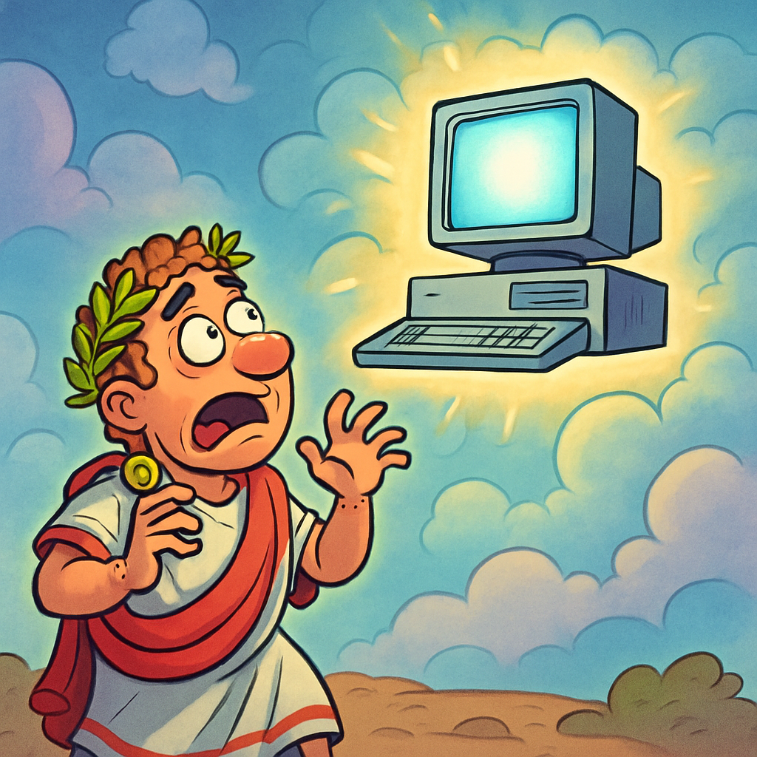
Caesar! We have another problem!
NOD CoDING BOOTCAMP PROJECT 1: MESSAGE ENCRYPTION TOOL
Computers have rendered your cipher completely useless!
1. A modern computer could easily discover the key by quickly testing all possible options
2. Even if that wasn’t the case, how can we exchange a key over the internet in the first place?

Slide 5
Solution: RSA Encryption!
NOD CoDING BOOTCAMP PROJECT 1: MESSAGE ENCRYPTION TOOL
RSA encryption uses an integer factorisation problem that digital computers find very difficult to solve.
Factoring numbers is hard!
What are the prime factors of
n = 7470451395944986
28369957449301448292019?
Answer:
p = 23058430092136939511
q = 32416190007117255629
Notes:
The "RSA" in RSA encryption stands for the surnames of its creators: Ron Rivest, Adi Shamir, and Leonard Adleman. They first publicly described the algorithm in 1977. RSA is a widely used asymmetric encryption algorithm that relies on the mathematical difficulty of factoring the product of two large prime numbers to secure data transmission. The name comes directly from the initials of these three inventors' last names.

Slide 6
Solution: RSA Encryption!
NOD CoDING BOOTCAMP PROJECT 1: MESSAGE ENCRYPTION TOOL
RSA encryption uses an integer factorisation problem that digital computers find very difficult to solve.
Factoring numbers is hard!
What are the prime factors of
n = 7470451395944986
28369957449301448292019?
Answer:
p = 23058430092136939511
q = 32416190007117255629
Notes:
The "RSA" in RSA encryption stands for the surnames of its creators: Ron Rivest, Adi Shamir, and Leonard Adleman. They first publicly described the algorithm in 1977. RSA is a widely used asymmetric encryption algorithm that relies on the mathematical difficulty of factoring the product of two large prime numbers to secure data transmission. The name comes directly from the initials of these three inventors' last names.

Slide 7
Solution: RSA Encryption!
NOD CoDING BOOTCAMP PROJECT 1: MESSAGE ENCRYPTION TOOL
RSA encryption uses an integer factorisation problem that digital computers find very difficult to solve.
Factoring numbers is hard!
What are the prime factors of
n = 7470451395944986
28369957449301448292019?
Answer:
p = 23058430092136939511
q = 32416190007117255629
Moreover, the encryption is asymmetric: different keys are used to encrypt and decrypt.
Notes:
The "RSA" in RSA encryption stands for the surnames of its creators: Ron Rivest, Adi Shamir, and Leonard Adleman. They first publicly described the algorithm in 1977. RSA is a widely used asymmetric encryption algorithm that relies on the mathematical difficulty of factoring the product of two large prime numbers to secure data transmission. The name comes directly from the initials of these three inventors' last names.

Slide 8


Solution: RSA Encryption!
NOD CoDING BOOTCAMP PROJECT 1: MESSAGE ENCRYPTION TOOL
RSA encryption uses an integer factorisation problem that digital computers find very difficult to solve.
Factoring numbers is hard!
What are the prime factors of
n = 7470451395944986
28369957449301448292019?
Answer:
p = 23058430092136939511
q = 32416190007117255629
Moreover, the encryption is asymmetric: different keys are used to encrypt and decrypt.
I can share the ‘public key’ with everyone to use for encryption.
I keep my ‘private key’ to use for decryption.
Notes:
The "RSA" in RSA encryption stands for the surnames of its creators: Ron Rivest, Adi Shamir, and Leonard Adleman. They first publicly described the algorithm in 1977. RSA is a widely used asymmetric encryption algorithm that relies on the mathematical difficulty of factoring the product of two large prime numbers to secure data transmission. The name comes directly from the initials of these three inventors' last names.

Slide 9
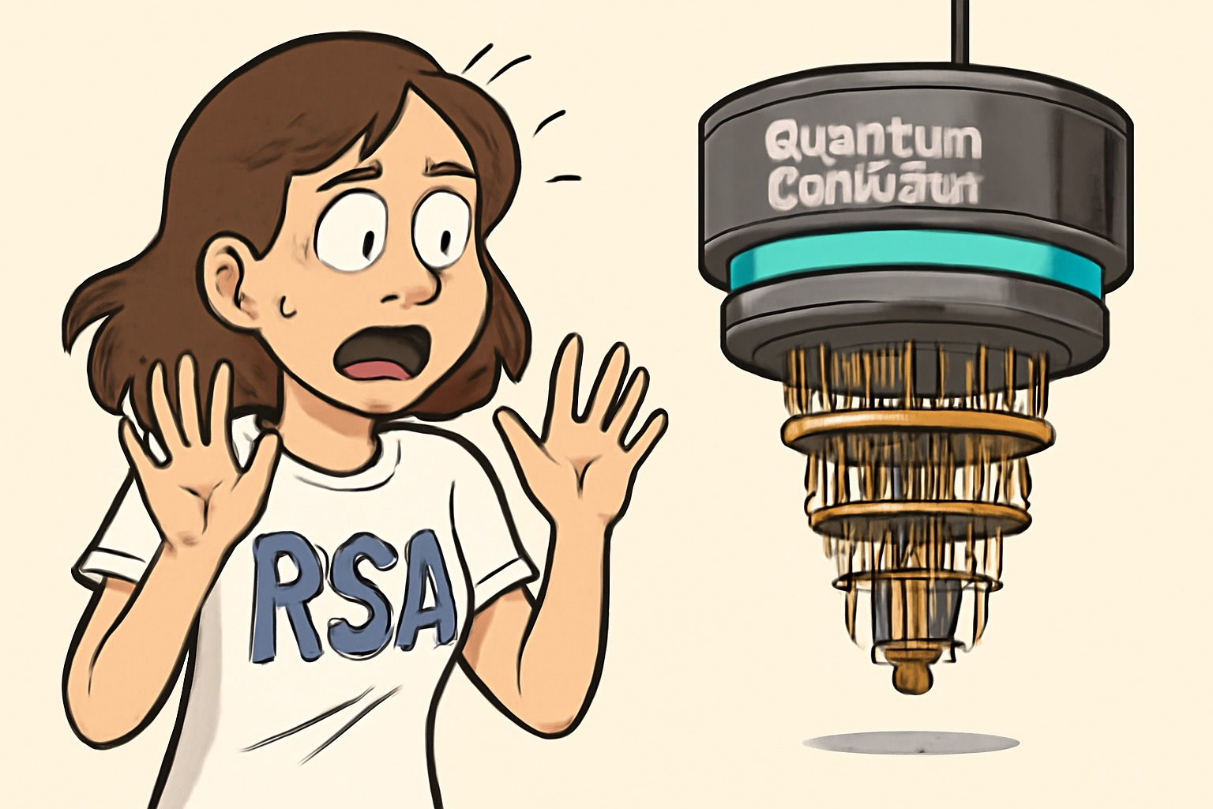
Caesar! We have a new problem!
NOD CoDING BOOTCAMP PROJECT 1: MESSAGE ENCRYPTION TOOL
Factoring of integers is easy if you have a quantum computer. This would make RSA encryption easy to break.
Development of quantum secure encryption algorithms is an important feature we need to add in the future!

